Slide 1
Belgian
legislation
Fire fighting
Conclusions

Slide 2
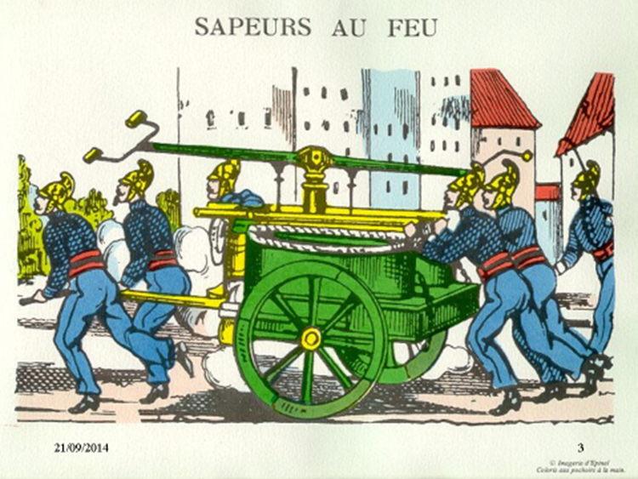
History
Belgian
legislation
Fire fighting
Conclusions

Slide 3



History
Belgian
legislation
Fire fighting
Conclusions
federal legislation
regional decree
technical manner
of erecting a construction
the use the owner is making
of his construction

Slide 4
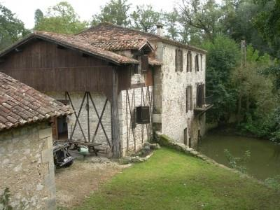

Belgian federal legislation
History
Belgian
legislation
Fire fighting
Conclusions
new
the European Regulation of Construction Products
Regional decree

Slide 5

History
Belgian
legislation
Fire fighting
Conclusions
35
and their relationship
with people
with reduced mobility

Slide 6
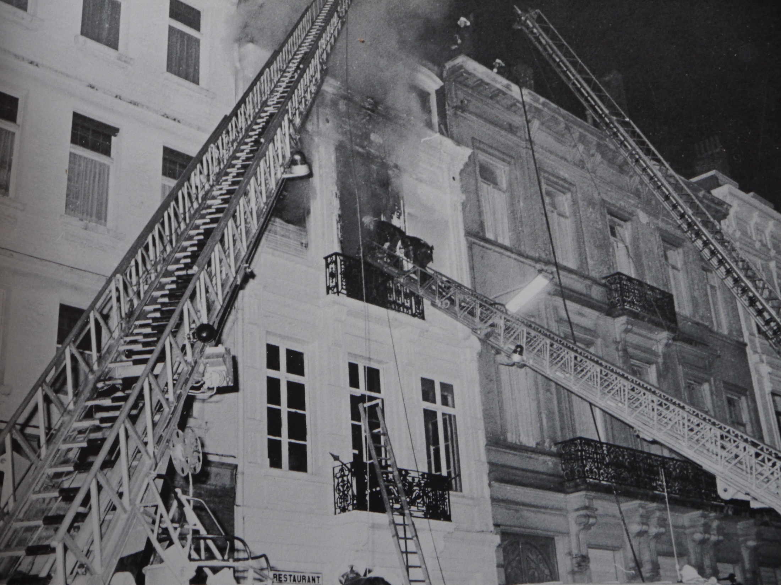
History
Belgian
legislation
Fire fighting
Conclusions

Slide 7
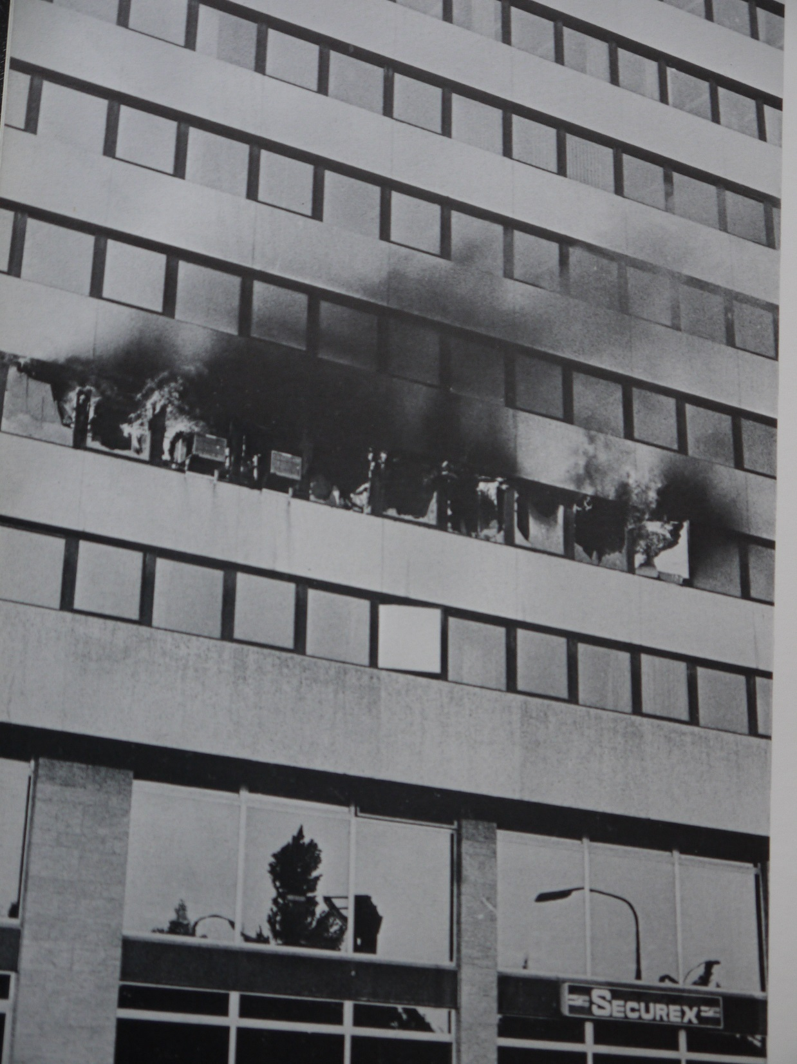
History
Belgian
legislation
Fire fighting
Conclusions

Slide 8
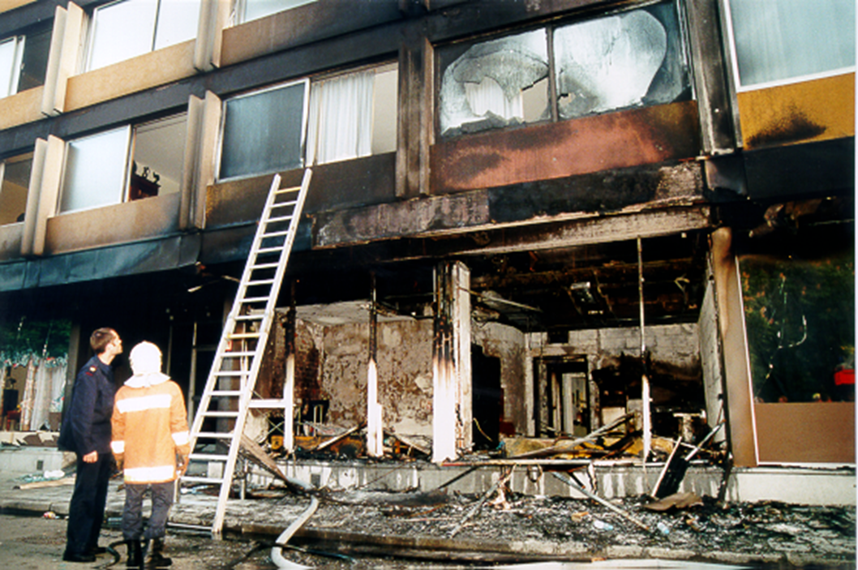
History
Belgian
legislation
Fire fighting
Conclusions
Fire « Senior Flatel » 98/05/20
v Roomfire (T.V.) groundfloor level
v Roomfire (T.V.)
groundfloor level
with heavy smoke production

Slide 9
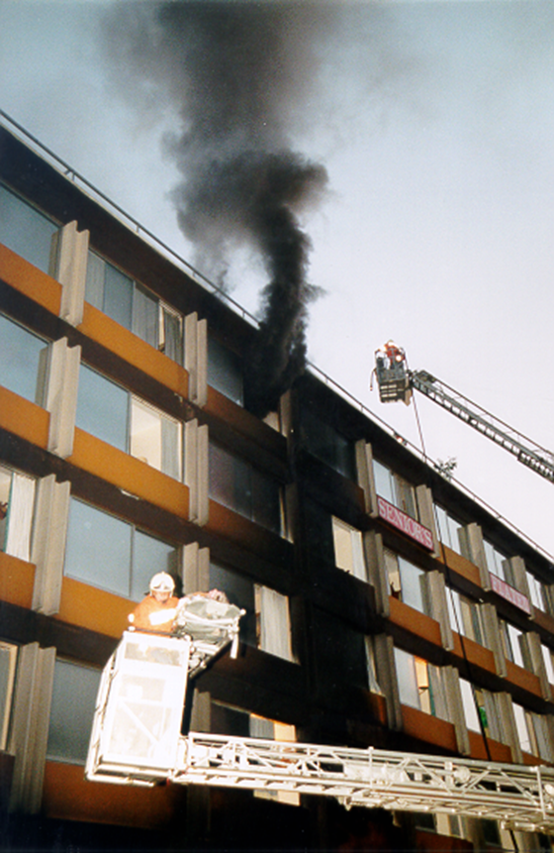
History
Belgian
legislation
Fire fighting
Conclusions
Fire « Senior Flatel » 98/05/20
v Roomfire (T.V.)
groundfloor level
with heavy smoke production

Slide 10




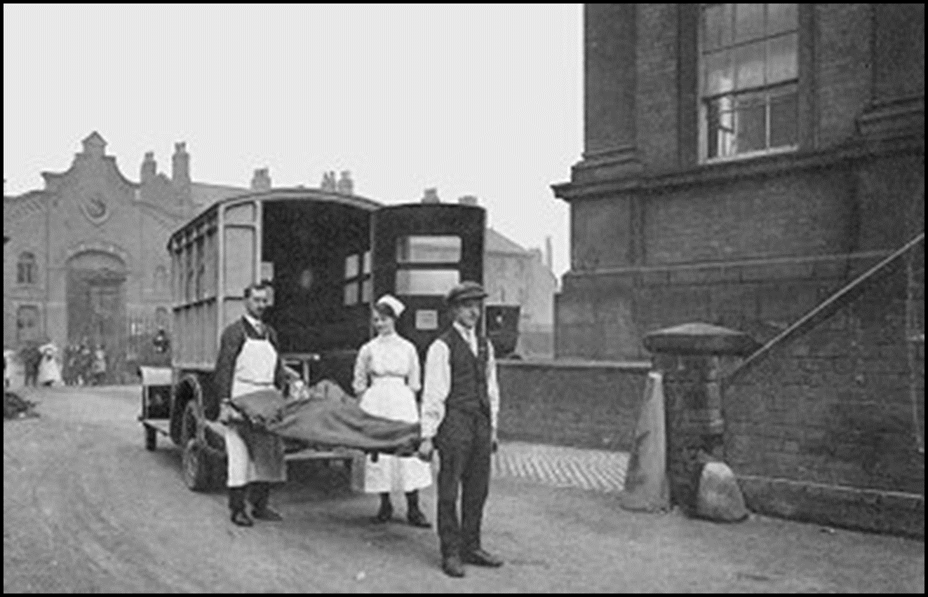
(
History
Belgian
legislation
Fire fighting
Conclusions
Upscaling
5
10

Slide 11
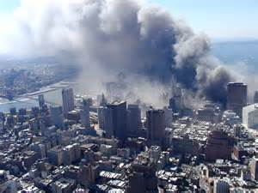
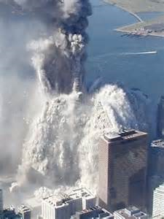
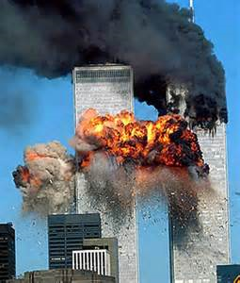

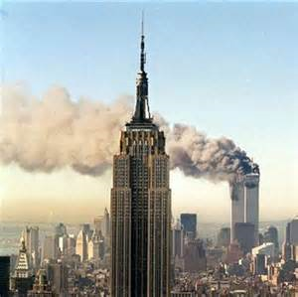

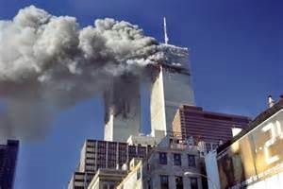
History
Belgian
legislation
Fire fighting
Happy-End
Story
Conclusions

Slide 12
History
Belgian
legislation
Fire fighting
Happy-End
Story
Conclusions
“ don’t worry ”
“ team work ”
“ accessibility for all ”
“ but evacuation for all ”

Slide 13
History
Belgian
legislation
Fire fighting
Happy-End
Story
Conclusions
I woud like to thank you
for your kind invitation
and for your attention

